Slide 1
RAMPAGE
Technical Post mortem

Slide 2
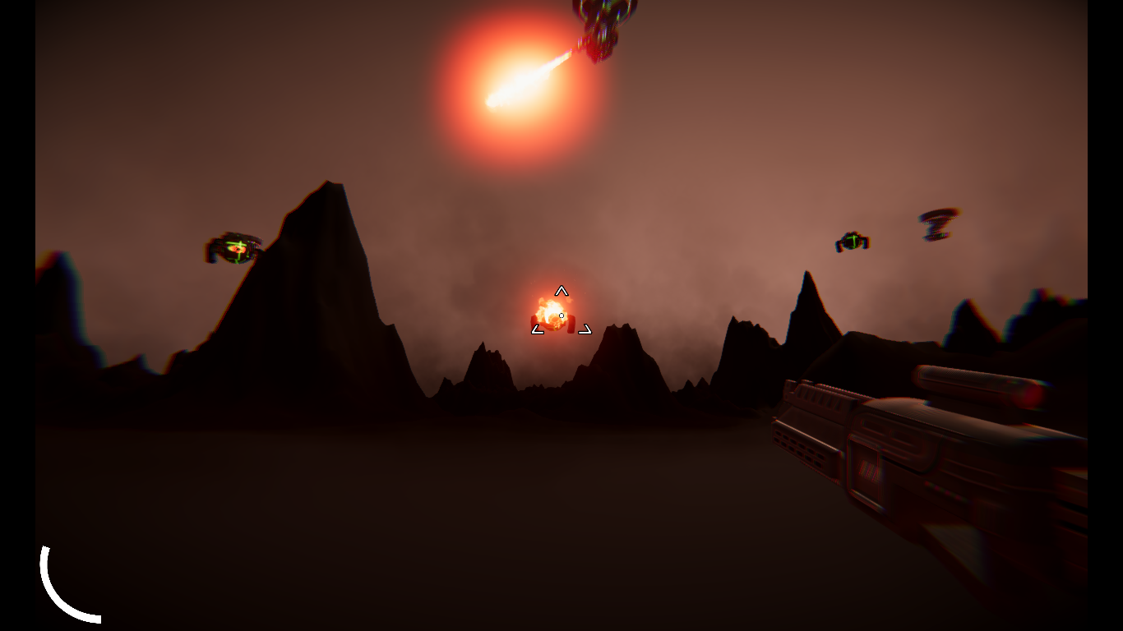
Screenshots

Slide 3
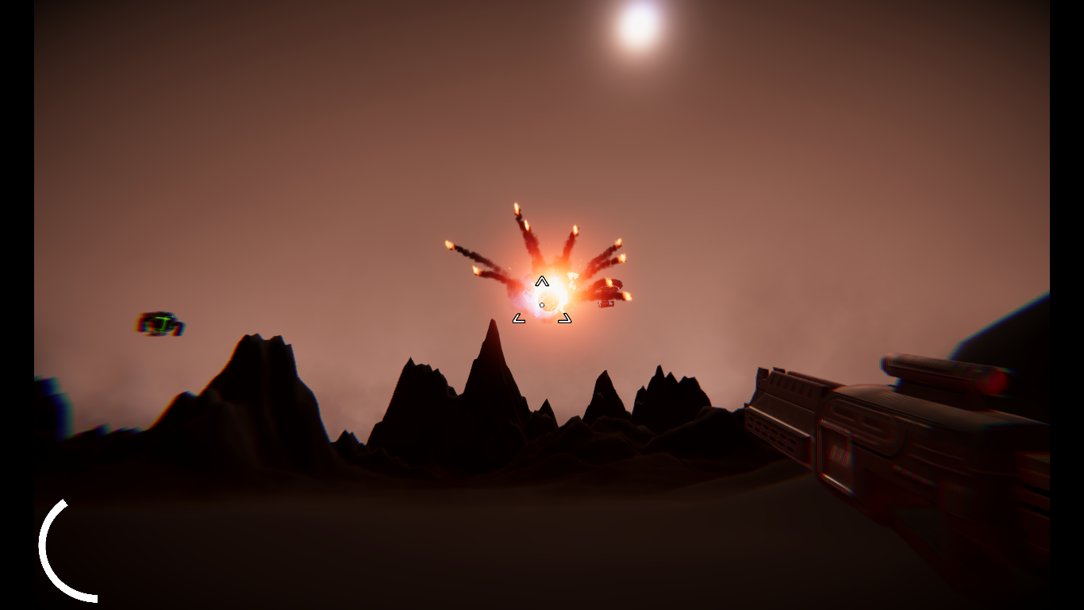
Screenshots

Slide 4
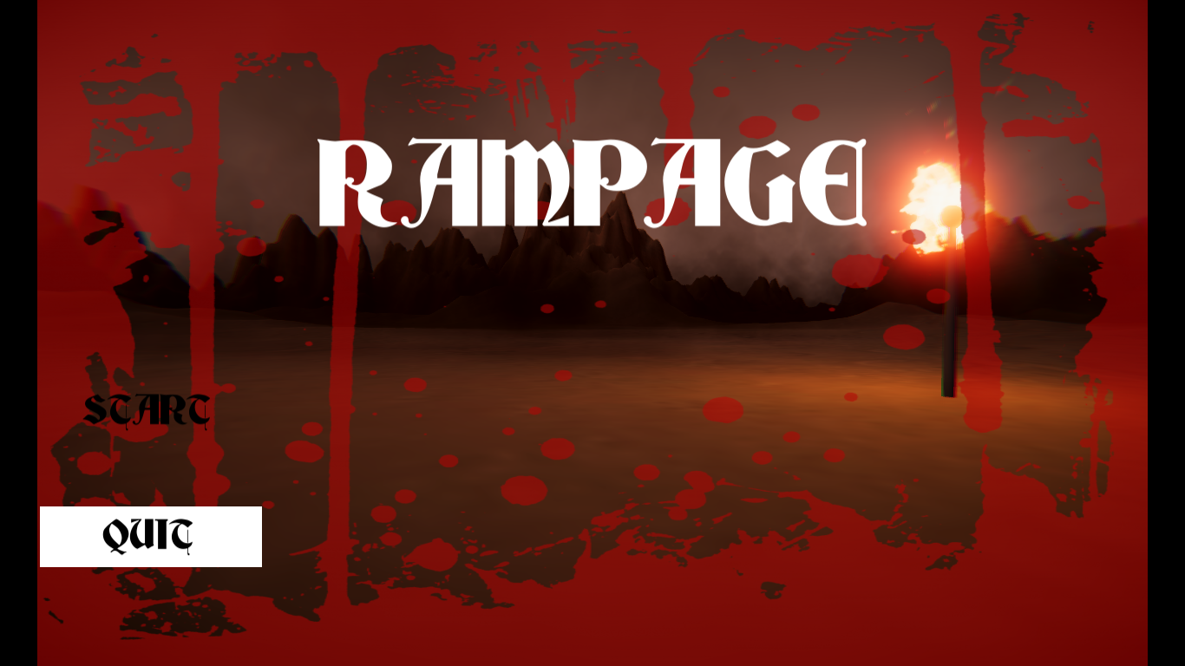
Screenshots

Slide 5
DEMO

Slide 6
4 key parts
Procedural Landmass Generation Rudra Nil Basu
Player Controls Rohit Das
Shooting Sumitra Chowdhury
Wave spawning Debayan De

Slide 7
Part 1: Procedural Landmass Generation
Rudra Nil Basu

Slide 8
Roadmap
1.1 Noise
Generating Height maps using Perlin Noise
Assign terrain types to various height ranges
Construct the 3D mesh using the above data
1.2 Level of Detail (LOD)
1.3 Endless Terrain

Slide 9
1.1 Generating Height maps using Perlin Noise

Slide 10

Noise
Regular Noise

Slide 11

Noise
Perlin Noise

Slide 12
Perline Noise
Coherent Noise
Changes occur gradually
Can help us to define our terrain
“Black” = lowest point
“White” = highest point

Slide 13
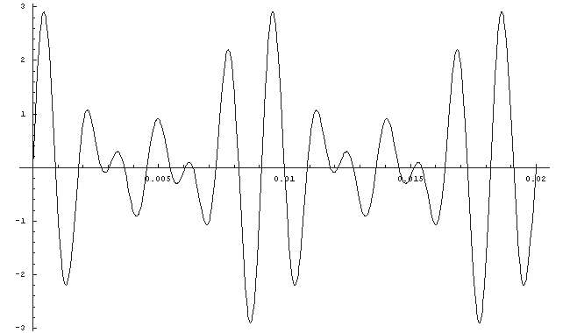
Problem?
Too smooth
We need to add details while preserving the shape of the terrain

Slide 14
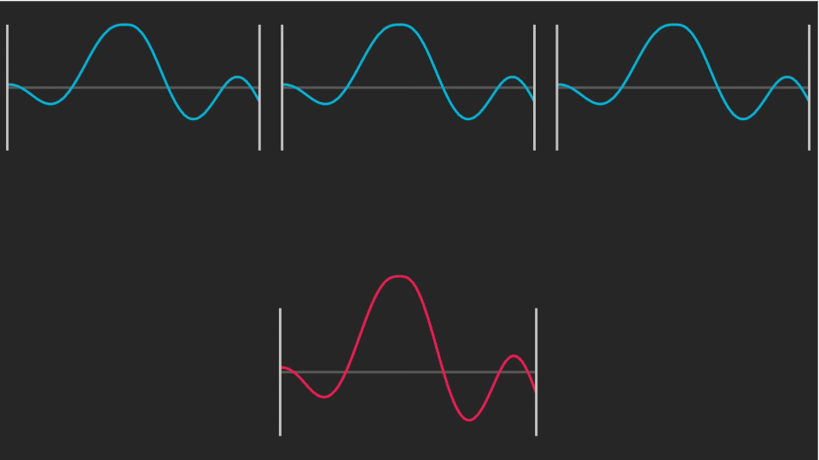
Solution?
Layer multiple levels of noise
Blue: 3 noise maps (called “octaves”)
Red: Result on adding all the octaves

Slide 15
Solution?
Layer multiple levels of noise
First Octave: Main Outline
Second Octave: Boulders
Third Octave: Small rocks
Red: Result on adding all the octaves

Slide 16
Solution?
Layer multiple levels of noise
First Octave: Main Outline
Second Octave: Boulders
Third Octave: Small rocks
Red: Result on adding all the octaves

Slide 17
Solution?
Layer multiple levels of noise
Each subsequent octaves will increase in details
Lacunarity: Controls increase in frequency over octaves

Slide 18
Solution?
Layer multiple levels of noise
Frequency = lacunarity ^ octave_no
Lacunarity: Controls increase in frequency over octaves

Slide 19
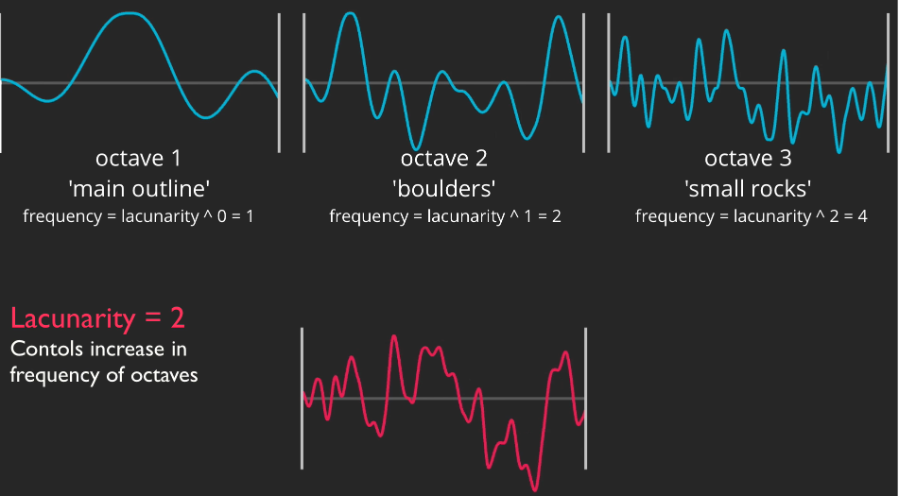
Solution?
Layer multiple levels of noise
As each octave increases in detail, it’s influence will diminish
Smaller rocks will have less influence on the outline

Slide 20
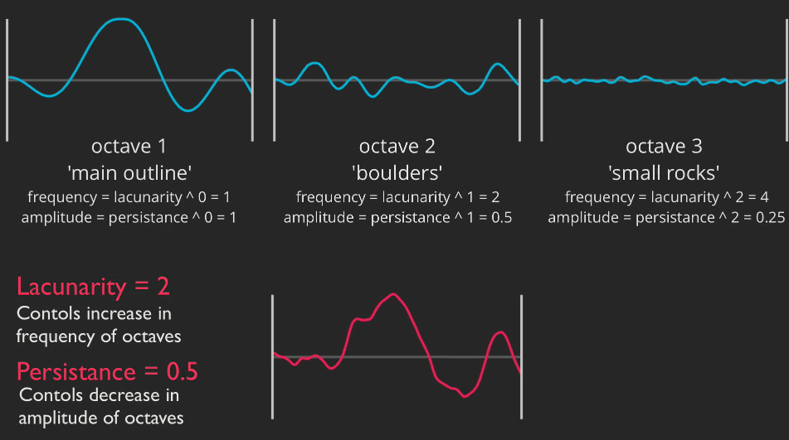
Solution?
Persistance
Control decrease in amplitude of octaves
Value: (0, 1)

Slide 21
Solution?

Slide 22
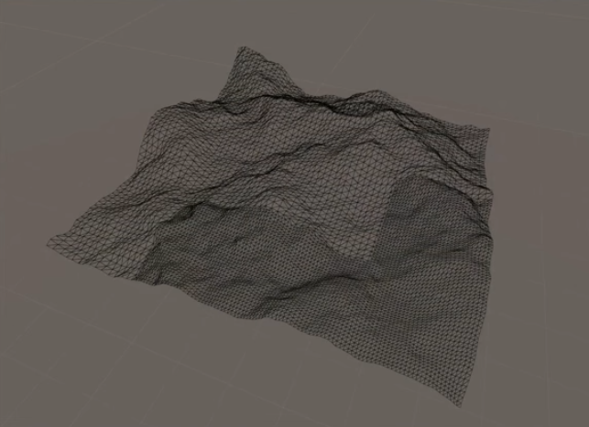
Result

Slide 23
1.2 LOD
Level of Detail

Slide 24
1.2 LOD
Multiple mesh resolutions

Slide 25
LOD: Why?
Low resolution = lower cost for rendering = faster
We do not need high resolution for landmass which are too far away for the player to view
Allows the game to run smoothly

Slide 26
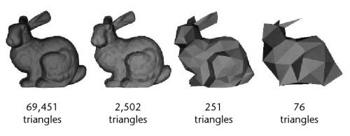
LOD: How?

Slide 27
LOD: How?
“Skip” few vertices for the mesh
Allow multiple levels of details depending on how close we are from the player

Slide 28
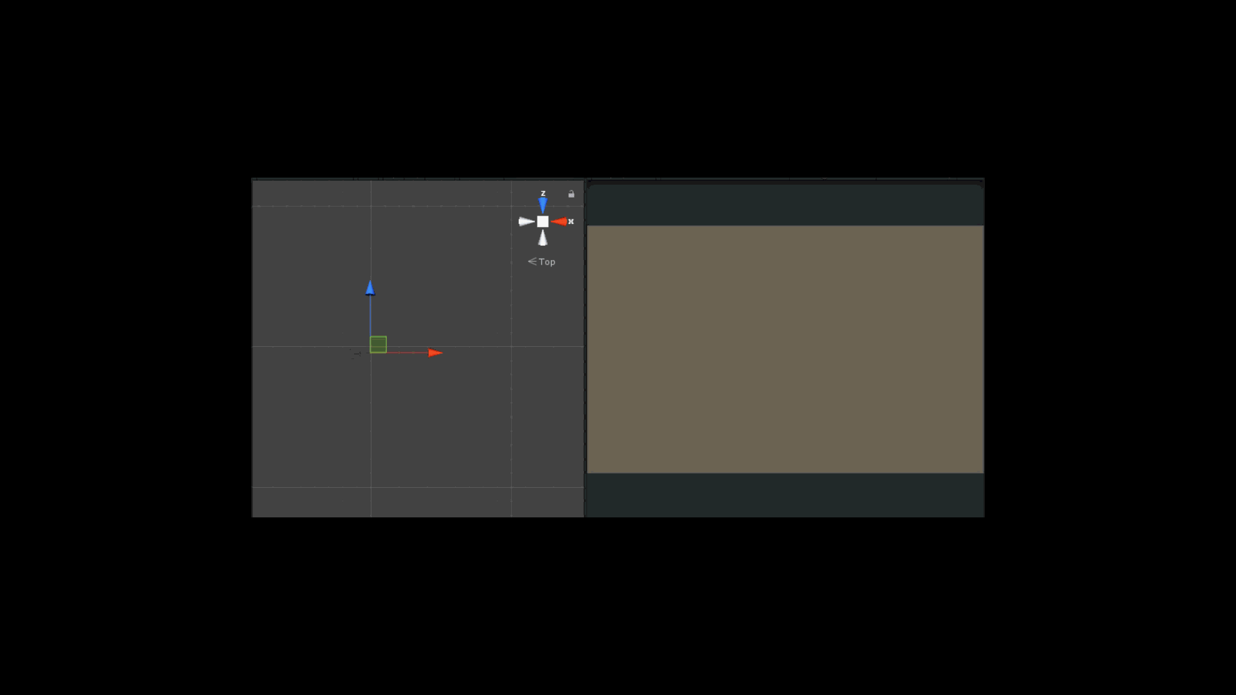
LOD

Slide 29
1.3 Endless Terrain

Slide 30

Endless Terrain

Slide 31
Basic idea
Only spawn chunks that are visible to the player
Hide them when they are not close enough
Dynamically change the level of detail depending on how far away they are w.r.t the player

Slide 32
Optimisation
Problem:
Too much calculation taking place in a single frame
Result:
- Game may freeze up while processing the information

Slide 33
Optimisation
Solution: Threading
- Spread the calculation of the map and the mesh on multiple frames

Slide 34
Part 2: Player controls
Rohit Das

Slide 35
Player controls
Controller: handles input, player state
Motor: Set of functions to implement actions of the player.
Motor: “Utility” script

Slide 36
Controller
Axis: Horizontal and Vertical
Horizontal: Detect movement along the X axis
Vertical: Detect movement along the Z axis
Values: [-1, 0, +1]
-1: Moving on the opposite direction
0: No movement along the axis
+1: Moving along the axis

Slide 37
Controller
Total Horizontal Movement:
(1, 0, 0) * horizontal_axis_value
Total Vertical Movement:
(0, 0, 1) * vertical_axis_value

Slide 38
Controller
Total Movement:
(Total horizontal movement + Total vertical movement).normalised * speed
Normalised: To ensure that the total length of the vector is 1
The movement vector is used as a direction, which is then multiplied by speed

Slide 39
Motor
The total movement from the controller is transferred to the Motor

Slide 40
Motor
For each frame:
* Player position for next frame= Current position * velocity * (time covered in the last frame)

Slide 41
Controller
Rotation
Rotation amount = (0, X axis rotation, 0) * sensitivity
The vector is sent to the motor to be applied

Slide 42
Motor
Rotation
Rotation in next frame = current rotation * new rotation vector around Y axis

Slide 43
Part 3: Shooting
Sumitra Chowdhury

Slide 44
Shooting
Player Shooting
Enemy Shooting

Slide 45
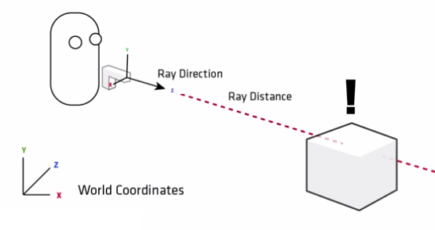
3.1 Player Shooting
Raycast
Casts a ray from the origin to a certain distance

Slide 46
3.1 Player Shooting
Raycast
Origin = Center of the camera
Physics.Raycast(ray, out hit)
Returns true if we hit something
if we do hit something, the properties of the collider is stored in “hit”

Slide 47
3.1 Player Shooting
On hitting an Enemy, call TakeDamage(int amt) method for the particular enemy

Slide 48
3.1 Player Shooting
TakeDamage(int amt)
health -= amt
if health <= 0:
Die();

Slide 49
3.2 Enemy Shooting
NOT a hit-scan weapon
=> Unlike Player Shooting, the bullet does not hit on the exact moment it was fired
Gives Player an advantage to overcome from being outnumbered

Slide 50
3.2 Enemy Shooting
When fired, the rotation vector of the bullet is set to “look at” the player
The bullet then translates towards the player in a forward direction
Collision detection: Detect when collider of the bullet has collided with collider of some other gameobject in the scene.
If collided with the player, call “TakeDamage(int)” method of the player

Slide 51
3.2 Enemy Shooting
Self Destruction: Destroy itself once it has been alive for a long time
Reason:
Optimisation

Slide 52
Part 4: Wave Spawner
Debayan De

Slide 53
Wave Spawner
Spawn waves of enemies one after the other

Slide 54
Wave Spawner
Properties that varies in a wave:
Number of enemies
Speed of the enemies
Max health
Generation rate of the enemies

Slide 55
Wave Spawner
States:
SPAWNING
WAITING
COUNTING

Slide 56
Wave Spawner
State: SPAWNING
Loop through the “enemy count” for a particular wave
Instantiate a particular enemy type, with particular properties, depending on the wave number
Wait for 1 / rate
Set state to WAITING once all enemies are instantiated

Slide 57
Wave Spawner
State: WAITING
Waits until all enemies for a particular wave are killed
Once all enemies are killed, change current state to COUNTING

Slide 58
Wave Spawner
State: COUNTING
Creates a countdown for starting the next wave
Increment the current wave number by one
Once the countdown reaches 0 change current state to SPAWNING

Slide 59
Future works

Slide 60
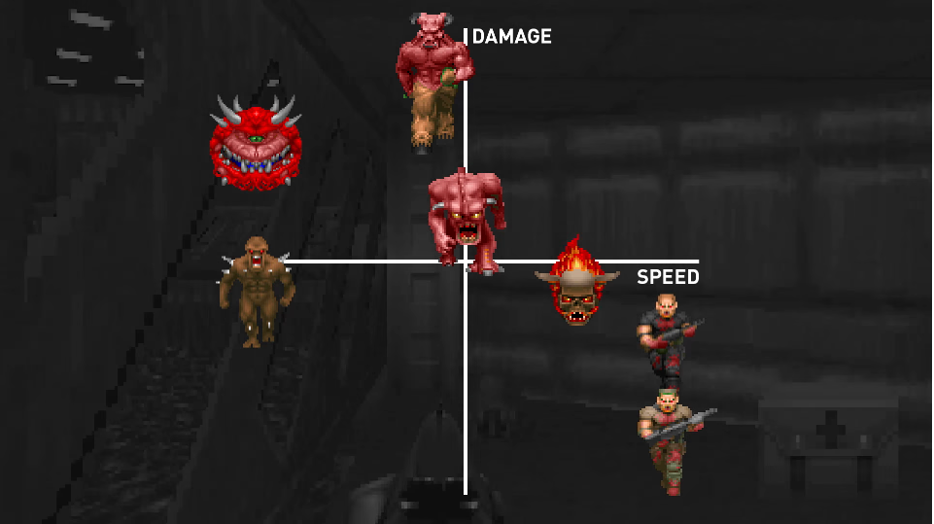
Future works
Implement Orthogonal Unit differentiation among the enemies
More resources (weapons) for the player
Greater possibility space for the player
Image: Mark Brown (youtube)

Slide 61
QUESTIONS?

Slide 62
THANK YOU

